Slide 1
Architectural style Farmhouse
By: Mikaela Leitzel

Slide 2
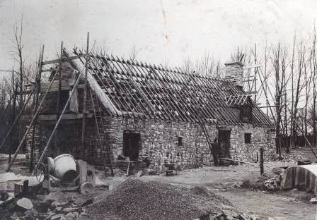
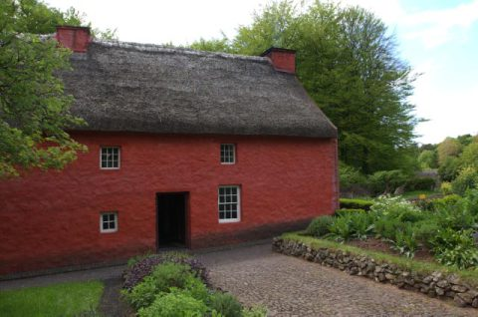
Farmhouse ~ Colonial Time Period
History:
Style:
16th century until the end of the 17th century
First found on the countryside of Quebec and Ontario.
Consisted usually of 2 stories, the bottom story was in place for anything other than the bedroom. The bedroom was always on the 2nd story.
Materials: Stone, timber logs, hay mixed with mud, and even berries.
Distinctive features: A chimney allowed there to be a closed roof, the rooves were shaped in a triangular prism, and there was now a 2nd level for sleeping.

Slide 3
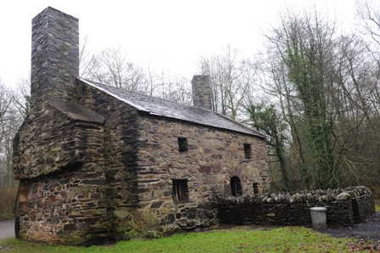
Farmhouse ~ Colonial time period
Style:
This style was intended mostly for only farmers and their families. Many of the farmhouses from this time period are still standing with little to no restoration.
This style was used mostly on fields of Scandinavia and Germany in Europe.
The purpose of the structure was to allow farmers to be at the farm earlier, and have a reliable place to live in the rural location. The design was more balanced and proportion because it was solely for comfortability and sturdiness. Red was typically the only color given to keep “evil spirits” away.

Slide 4
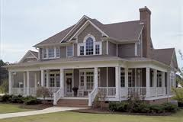
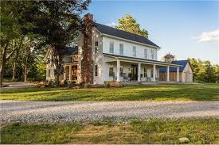
Farmhouse ~ Modern time period
History:
Style:
1930’s through the 1940’s
Found in the United States countryside.
Also, consist of usually 2 stories; however, the 2nd story has more availability for more than just bedrooms.
Materials: Electrical pumps, wooden clapboard siding, brick, quarried stone.
Distinctive features: A wrap around porch, an electrical pump to disperse electricity throughout the home, and more space is given on the exterior design.

Slide 5
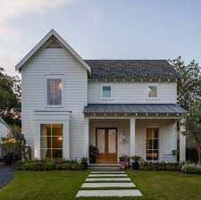
Farmhouse ~ Modern time period
Style:
The balance and proportion of the farmhouses were very basic, and served more for stability than appearance.
Farmhouses were used for residents, and the more modern ohmes were found prominently in the United States on country land as well as the start of home developments.
The purpose of this house was to create a more spacious/comfortable home. During the Great Depression farmhouses also had been a home that was given to city dwellers because it was cheaper to make, and had an electrical pump available.

Slide 6
Resources
http://houseplansandmore.com/resource_center/farmhouse-history.aspx
https://museum.wales/stfagans/buildings/garregfawr/
http://www.hgtv.com/design/home-styles/farmhouse-architecture
http://www.stillwaterarchitecture.com/blog/five-elements-of-modern-farmhouse-design/
*Pictures have a hyperlink attached.

